Slide 1
Introduction and History of Python and Functions &MOdules
by
Thathireddy Eswar Reddy

Slide 2
Introduction of Python

Slide 3
What is python?
Python is a high-level, interpreted programming language.
It emphasizes code readability with its clear and concise syntax.
It supports multiple programming paradigms, including procedural, object- oriented, and functional programming.

Slide 4
Key Features
Easy to Learn: Simple and intuitive syntax similar to plain English.
Versatile: Used for web development, data analysis, automation, scientific computing, AI/ML, and more.
Cross-Platform: Works on Windows, macOS, Linux, and other systems.
Large Community Support: Vast library ecosystem with modules for various tasks (e.g., NumPy, Pandas, Django, etc.).

Slide 5
History of Python

Slide 6
Origin and Creation
Creator: Python was created by Guido van Rossum.
Initial Development: Began in the late 1980s.
First Release: Python was officially released in 1991.
Inspiration: Van Rossum based Python on ABC, a language he helped develop at Centrum Wiskunde & Informatica (CWI) in the Netherlands.
Named after Monty Python’s Flying Circus, reflecting van Rossum's love for humor.

Slide 7
Early Development Phases
Python 1.0 (1994)
Introduced core features like exception handling, functions, and core data types (lists, strings, etc.).
Module system and basic syntax were established.
Python 2.0 (2000)
New Features:
List comprehensions.
Garbage collection (memory management improvement).
Unicode support for strings.
End of Support: Python 2.x reached its end of life in January 2020.

Slide 8
Modern Era of Python
Python 3.0 (2008) 3
Major overhaul to remove redundancies and improve performance.
Key Changes:
Print function (from print statement to print() function).
New integer division behavior (e.g., 5/2 returns 2.5 instead of 2).
Improved string handling with native Unicode support.
Migration from Python 2 to Python 3 was challenging for many, but it brought cleaner syntax and better features.

Slide 9
Python Today
Current Version: Python 3.x (with regular updates, as of 2024 Python 3.12 is the latest stable version).
Widespread Adoption:
Used by tech giants like Google, Netflix, and NASA.
Popular in academia, data science, web development, automation, and AI.
Significant rise in demand due to the machine learning and data analysis boom.
Community and Growth:
One of the largest and most active programming communities.
Extensive library ecosystem with over 300,000 packages available on PyPI (Python Package Index).

Slide 10
Why Python?
Beginner-Friendly: Perfect for those new to programming.
Versatility: Can be used for small scripting tasks to large-scale enterprise solutions.
Extensive Libraries and Frameworks:
Web Development: Flask, Django.
Data Science: Pandas, NumPy, SciPy.
Machine Learning: TensorFlow, Scikit-learn, Keras.
Conclusion:
Python’s simplicity, readability, and adaptability have made it one of the most popular languages in the world, and it continues to evolve.

Slide 11
Functions & MOdules

Slide 12
Introduction to Functions in Python
What is a Function?
A function is a block of reusable code designed to perform a specific task.
Functions allow code to be organized, modular, and reusable.
Advantages of Using Functions:
Code Reusability: Write once, use many times.
Modularity: Break down complex programs into simpler, manageable pieces.
Ease of Maintenance: Easier to debug and maintain code.

Slide 13
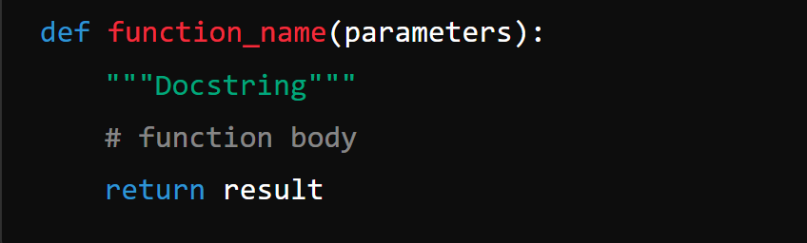
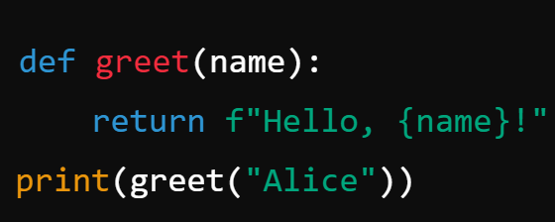
Defining and Calling Functions
Defining a Function: Example:

Slide 14
Function Definition Components:
def: Keyword used to define a function.
function_name: Name of the function.
parameters: Input values to the function.
return: Returns a result or output from the function.

Slide 15
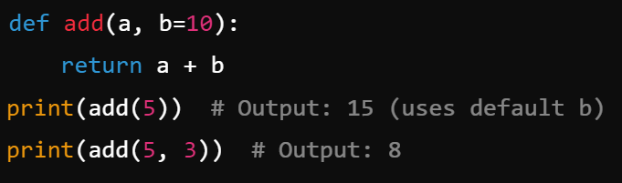
Function Arguments and Parameters
Types of Function Arguments:
Positional Arguments: Passed in order (e.g., greet("Alice")).
Keyword Arguments: Passed with a key-value pair (e.g., greet(name="Alice")).
Default Arguments: Predefined values if no argument is passed (e.g., def greet(name="Guest")).
Arbitrary Arguments: For variable-length arguments using *args and **kwargs.
Example:

Slide 16
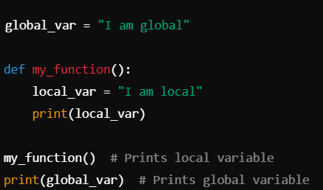
Scope and Lifetime of Variables
Local vs Global Variables:
Local Variables: Declared inside a function and only accessible within that function.
Global Variables: Declared outside any function and accessible throughout the code.
Example :

Slide 17
Introduction to Modules in Python
What is a Module?
A module is a file containing Python code (functions, classes, and variables) that can be reused across multiple programs.
Python modules provide better code organization and reusability.
Built-in Modules:
Python comes with several built-in modules, such as math, os, sys, random, etc.
Third-Party Modules:
External libraries that can be installed using pip (e.g., numpy, pandas, requests).

Slide 18
Importing Modules
How to Import a Module:
Basic Import:
import math
print(math.sqrt(16)) # Output: 4.0
Import Specific Function:
from math import sqrt
print(sqrt(16)) # Output: 4.0
Using Aliases:
import math as m
print(m.sqrt(16)) # Output: 4.0

Slide 19
Creating and Using Custom Modules
Creating a Custom Module:
Save the following code in a file named my_module.py:
def greet(name):
return f"Hello, {name}!"
Using the Custom Module
import my_module
print(my_module.greet("Alice")) # Output: Hello, Alice!

Slide 20
Packages in Python
What is a Package?
A package is a collection of related modules stored in a directory with an __init__.py file.
Organizing Code with Packages:
Example package structure:
my_package/
__init__.py
module1.py
module2.py
Importing from Packages:
from my_package import module1

Slide 21
Advantages of Using Modules
Code Organization: Break large projects into smaller, more manageable parts.
Reusability: Use the same module in multiple projects.
Namespace Management: Modules provide their own namespaces, preventing naming conflicts.
Collaboration: Teams can work on separate modules and combine them in a larger project.

Slide 22
Conclusion for Introduction to Python & History of Python
Python’s Evolution:
Python has grown from a simple, easy-to-learn language into one of the most popular and versatile programming languages in the world.
Its journey, from its creation by Guido van Rossum in 1991 to its widespread adoption today, reflects its adaptability and powerful community-driven development.
Why Python Matters:
Python’s simplicity, extensive libraries, and wide-ranging applications make it a perfect choice for beginners and professionals alike.
From web development to machine learning and data science, Python continues to shape modern computing and drive technological innovation.

Slide 23
Conclusion for Functions and Modules in Python
The Power of Functions and Modules:
Functions help break down complex code into reusable, modular blocks, improving the clarity, organization, and maintainability of your programs.
Modules allow for efficient code organization, reusability, and collaboration by providing a way to store and import functions, classes, and variables across different programs.
Efficiency and Flexibility:
Using functions and modules enables developers to write cleaner, more efficient, and scalable code, making Python a powerful tool for both small projects and large-scale software development.
Building Blocks of Larger Projects:
Together, functions and modules promote best practices in software development, allowing developers to work more efficiently, solve problems collaboratively, and build robust applications.

Slide 24
THANK YOU

